Slide 1
Software Testing
Rajib Mall
CSE Department
IIT KHARAGPUR

Slide 2
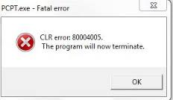
Faults and Failures
A program may fail during testing:
  A manifestation of a fault (also called defect or bug).
  Mere presence of a fault may not lead to a failure.

Slide 3
Errors, Faults, Failures
Programming is human effort-intensive:
  Therefore, inherently error prone.
IEEE std 1044, 1993 defined errors and faults as synonyms :
IEEE Revision of std 1044 in 2010 introduced finer distinctions:
  To support more expressive communications, it distinguished between Errors and Faults

Slide 4

Design
Fault, defect, or bug
Error or mistake
Failure
Specification
Code

Slide 5

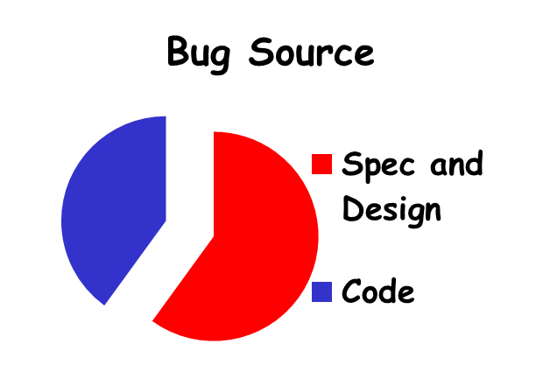
A Few Error Facts
Even experienced programmers make many errors:
  Avg. 50 bugs per 1000 lines of source code
Extensively tested software contains:
  About 1 bug per 1000 lines of source code.
Bug distribution:
  60% spec/design, 40% implementation.
Notes:
© SE, Testing, Hans van Vliet

Slide 6
How to Reduce Bugs?
Review
Testing
Formal specification and verification
Use of development process

Slide 7
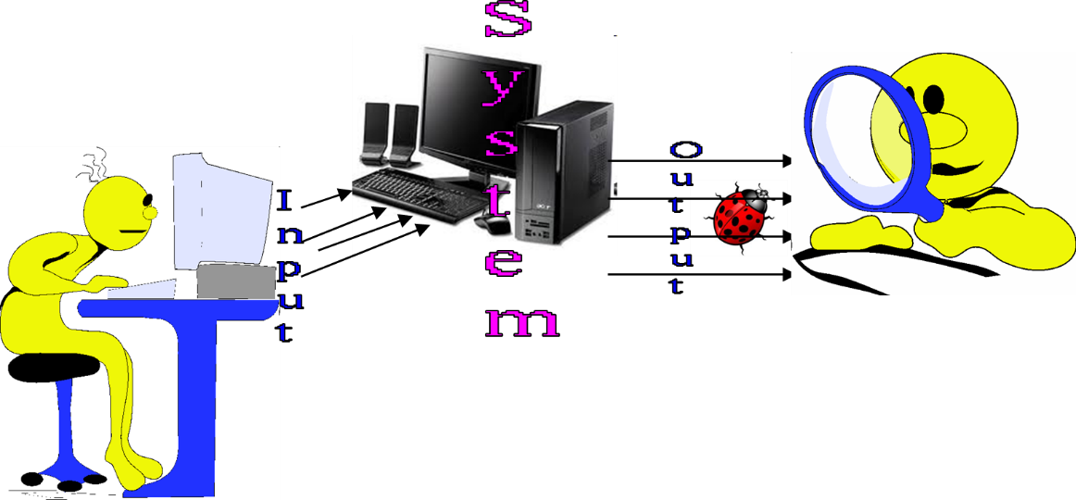
How to Test?
Input test data to the program.
Observe the output:
  Check if the program behaved as expected.

Slide 8
Examine Test Result…
If the program does not behave as expected:
  Note the conditions under which it failed (Test report).
  Later debug and correct.

Slide 9
Testing Facts
Consumes the largest effort among all development activities:
  Largest manpower among all roles
  Implies more job opportunities
About 50% development effort
  But 10% of development time?
  How?

Slide 10
Testing Facts
Testing is getting more complex and sophisticated every year.
  Larger and more complex programs
  Newer programming paradigms
  Newer testing techniques
  Test automation

Slide 11
Testing Perception
Testing is often viewed as not very challenging --- less preferred by novices, but:
  Over the years testing has taken a center stage in all types of software development.
  “Monkey testing is passe” --- Large number of innovations have taken place in testing area --- requiring tester to have good knowledge of test techniques.
  Challenges of test automation

Slide 12



Monkey Testing is Passe…
Testing through random inputs.
Problems:
  Many program parts may not get tested.
  Risky areas of a program may not get tested.
  The tester may not be able to reproduce the failure.
Two types of monkeys:
Dumb monkey
Smart monkey

Slide 13
Verification versus Validation
Verification is the process of determining:
  Whether output of one phase of development conforms to its previous phase.
Validation is the process of determining:
  Whether a fully developed system conforms to its SRS document..

Slide 14
Verification versus Validation
Verification is concerned with phase containment of errors:
  Whereas, the aim of validation is that the final product is error free.

Slide 15
Verification and Validation Techniques
Review
Simulation
Unit testing
Integration testing
System testing

Slide 16
Testing Levels

Slide 17
4 Testing Levels
Software tested at 4 levels:
  Unit testing
  Integration testing
  System testing
  Regression testing

Slide 18
Test Levels
Unit testing
  Test each module (unit, or component) independently
  Mostly done by developers of the modules
Integration and system testing
  Test the system as a whole
  Often done by separate testing or QA team
Acceptance testing
  Validation of system functions by the customer

Slide 19
Levels of Testing
What users
really need
Acceptance
testing
Requirements
System testing
System testing
Design
Integration testing
Integration testing
Code
Unit testing
Unit testing
Maintenance
Regression Testing

Slide 20
Basic Concepts in Testing

Slide 21
Overview of Activities During System and Integration Testing
Test Suite Design
Run test cases
Check results to detect failures.
Prepare failure list
Debug to locate errors
Correct errors.
Tester
Developer

Slide 22
Quiz 1
As testing proceeds more and more bugs are discovered.
  How to know when to stop testing?
Give examples of the types of bugs detected during:
  Unit testing?
  Integration testing?
  System testing?

Slide 23
Unit testing
During unit testing, functions (or modules) are tested in isolation:
  What if all modules were to be tested together (i.e. system testing)?
    It would become difficult to determine which module has the error.

Slide 24
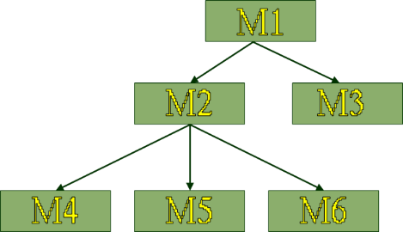
Integration Testing
After modules of a system have been coded and unit tested:
  Modules are integrated in steps according to an integration plan
  The partially integrated system is tested at each integration step.

Slide 25
Integration and System Testing
Integration test evaluates a group of functions or classes:
  Identifies interface compatibility, unexpected parameter values or state interactions, and run-time exceptions
  System test tests working of the entire system
Smoke test:
  System test performed daily or several times a week after every build.

Slide 26
Types of System Testing
Based on types test:
  Functionality test
  Performance test
Based on who performs testing:
  Alpha
  Beta
  Acceptance test

Slide 27
Performance test
Determines whether a system or subsystem meets its non-functional requirements:
    Response times
    Throughput
    Usability
    Stress
    Recovery
    Configuration, etc.

Slide 28
User Acceptance Testing
User determines whether the system fulfills his requirements
  Accepts or rejects delivered system based on the test results.

Slide 29
Who Tests Software?
Programmers:
  Unit testing
  Test their own or other’s programmer’s code
Users:
  Usability and acceptance testing
  Volunteers are frequently used to test beta versions
Test team:
  All types of testing except unit, beta, and acceptance
  Develop test plans and strategy

Slide 30
V&V
Feasibility Study
Req. Analysis
Design
Testing by developers
Coding
Testing by Tester
Review,
Simulation, etc.
Testing
Maintenance

Slide 31
Pesticide Effect
Errors that escape a fault detection technique:
  Can not be detected by further applications of that technique.
F
I
L
T
E
R
F
I
L
T
E
R
F
I
L
T
E
R
F
I
L
T
E
R

Slide 32
Capers Jones Rule of Thumb
Each of software review, inspection, and test step will find 30% of the bugs present.
In IEEE Computer, 1996

Slide 33
Pesticide Effect
Assume to start with 1000 bugs
We use 4 fault detection techniques :
  Each detects only 70% bugs existing at that time
  How many bugs would remain at end?
  1000*(0.3)⁴=81 bugs

Slide 34
Quiz
Feasibility Study
When are verification undertaken in waterfall model?
When is testing undertaken in waterfall model?
When is validation undertaken in waterfall model?
Req. Analysis
Design
Coding
Testing
Maintenance

Slide 35
After Testing is Complete, How Many Latent Errors?
Several independent studies [Jones],[schroeder], etc. conclude:
  85% errors get removed at the end of a typical testing process.
  Why not more?
  All practical test techniques are basically heuristics… they help to reduce bugs… but do not guarantee complete bug removal…

Slide 36
Test Cases
Each test case typically tries to establish correct working of some functionality:
  Executes (covers) some program elements.
  For certain restricted types of faults, fault-based testing can be used.

Slide 37
Test data versus test cases
Test data:
  Inputs used to test the system
Test cases:
  Inputs to test the system,
  State of the software, and
  The predicted outputs from the inputs

Slide 38
Test Cases and Test Suites
A test case is a triplet [I,S,O]
  I is the data to be input to the system,
  S is the state of the system at which the data will be input,
  O is the expected output of the system.

Slide 39
Test Cases and Test Suites
Test a software using a set of carefully designed test cases:
  The set of all test cases is called the test suite.

Slide 40
What are Negative Test Cases?
Purpose:
  Helps to ensure that the application gracefully handles invalid and unexpected user inputs and the application does not crash.
Example:
  If user types letter in a numeric field, it should not crash but politely display the message: “incorrect data type, please enter a number…”

Slide 41
Test Execution Example: Return Book
Test case [I,S,O]
Set the program in the required state: Book record created, member record created, Book issued
Give the defined input: Select renew book option and request renew for a further 2 week period.
Observe the output:
  Compare it to the expected output.

Slide 42
Sample: Recording of Test Case & Results
Test Case number
Test Case author
Test purpose
Pre-condition:
Test inputs:
Expected outputs (if any):
Post-condition:
Test Execution history:
  Test execution date
  Person executing Test
  Test execution result (s) : Pass/Fail
    If failed : Failure information and fix status

Slide 43
Test Team ---Required Human Resources
Test Planning: Experienced people
Test scenario and test case design: Experienced and test qualified people
Test execution: semi-experienced to inexperienced
Test result analysis: experienced people
Test tool support: experienced people
May include external people:
  Users
  Industry experts

